Slide 1
6. Jointly Distributed Random Variables

Slide 2
Contents
Joint Distribution Functions
Independent Random Variables
Sums of Independent Random Variables
Conditional Distributions: Discrete Case
Conditional Distributions: Continuous Case
Order Statistics
Joint Probability Distribution of Functions of Random Variables
Exchangeable Random Variables

Slide 3
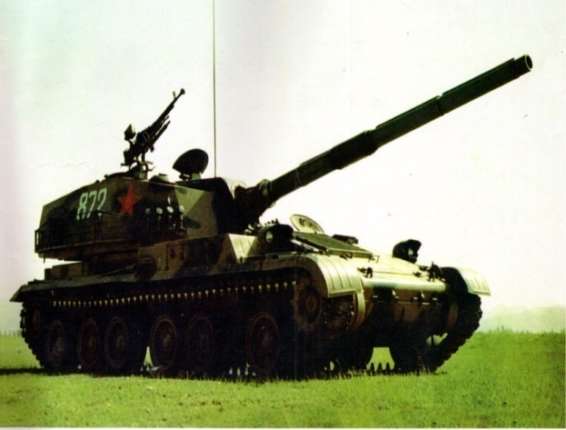
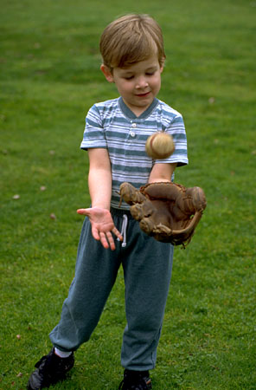
6.1 Joint Distribution Functions
Why introducing Joint distribution?
Example 1 Shooting rate
Position (X,Y)
Example 2 Investigate the growth of children
Height and weight (H,W)

Slide 4

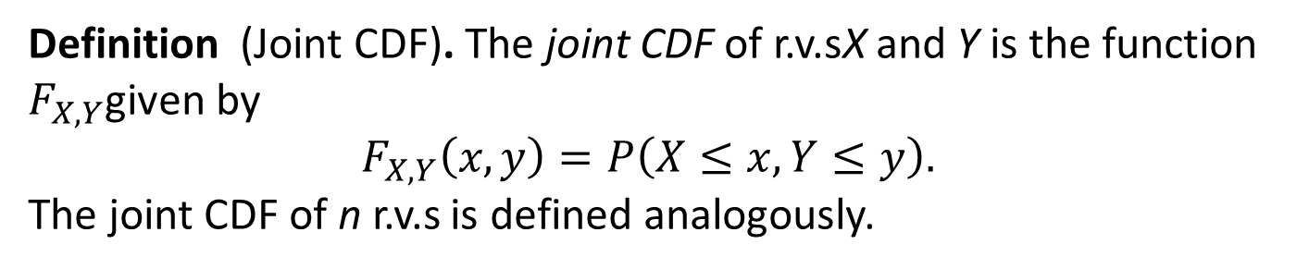
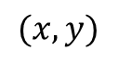
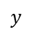

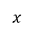
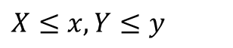
6.1 Joint Distribution Functions
Definition (Joint CDF). The joint CDF of r.v.sX and Y is the function $F_{X,Y}$given by
$$F_{X,Y}\left(x,y\right)=P\left(X≤x,Y≤y\right).$$ The joint CDF of n r.v.s is defined analogously.
$$y$$
$$(x,y)$$
$$•$$
$$X≤x,Y≤y$$
$$o$$
$$x$$

Slide 5
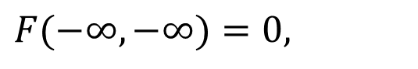
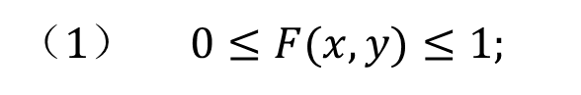
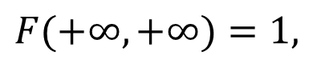

Joint CDF’s properties
$$（1） 0≤F(x,y)≤1;$$
$$（2） F\left(x,y\right) is \text{monotonic} nondecreasing about x y：$$
$$when x_{1}<x_{2} , F(x_{1},y)≤F(x_{2},y) ,∀y∈(−∞,+∞)，$$
$$when y_{1}<y_{2} 时,F(x,y_{1})≤F(x,y_{2}) ,∀x∈(−∞,+∞).$$
$$(3) limits：$$
$$F(+∞,+∞)=1,$$
$$F(−∞,−∞)=0,$$
$$F(−∞,y)=0, ∀ y∈(−∞,+∞),$$
$$F(x,−∞)=0, ∀ x∈(−∞,+∞)$$

Slide 6
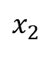
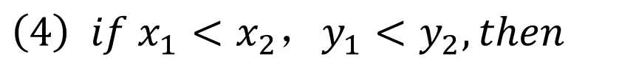
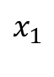
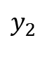
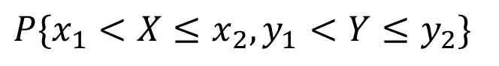
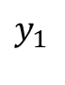
Joint CDF’s properties
$$\left(4\right) if x_{1}<x_{2}，y_{1}<y_{2}, then$$
$$P\{{x_{1}<X≤x_{2},y}_{1}<Y≤y_{2}\}$$
$$=$$
$$F(x_{2},y_{2})−F(x_{2},y_{1})+F(x_{1},y_{1})−F(x_{1},y_{2}).$$
$$y_{2}$$
$$y_{1}$$
$$x_{1}$$
$$x_{2}$$
All properties are applicable to discrete and continuous r.v.s

Slide 7
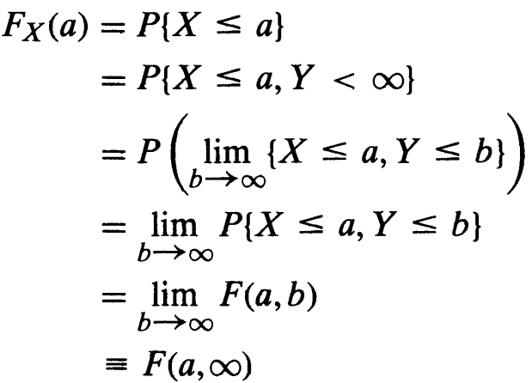
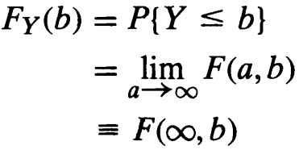
Understanding Joint CDF’s properties

Slide 8
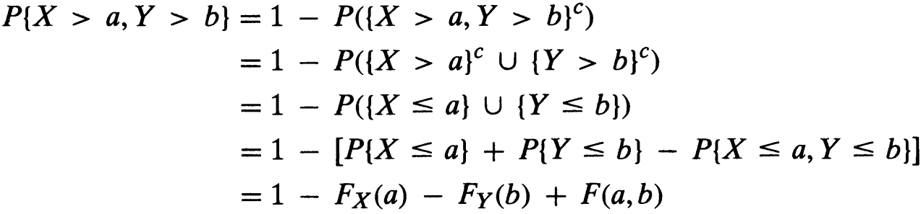
Understanding Joint CDF’s properties

Slide 9
Example 6.1a
For 2D r.v.s (X,Y), the joint CDF is :
F(x,y)=A(B+arctan x)(C+acrtan y)
To find A, B , C.

Slide 10
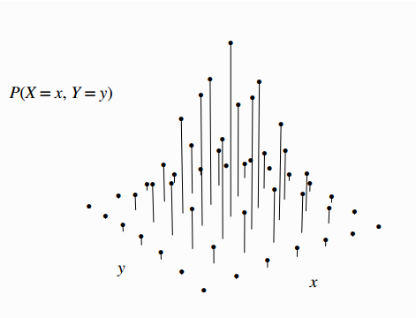
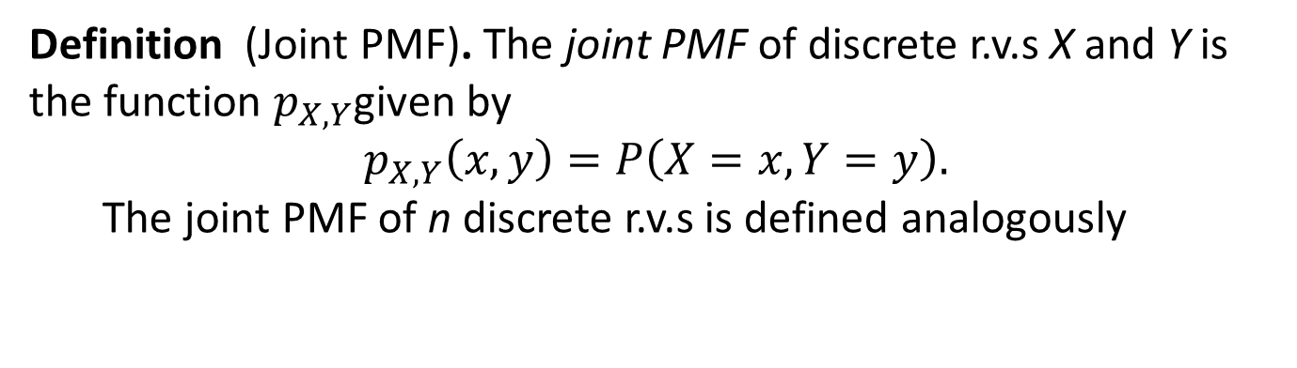
Joint PMF for discrete r.v.s
Definition (Joint PMF). The joint PMF of discrete r.v.s X and Y is the function $p_{X,Y}$given by $$p_{X,Y}\left(x,y\right)=P\left(X=x,Y=y\right).$$
The joint PMF of n discrete r.v.s is defined analogously

Slide 11
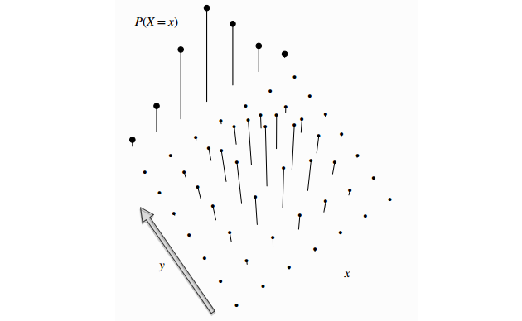

Marginal PMF for discrete r.v.s
Definition (Marginal PMF). For discrete r.v.s X and Y , the marginal PMF of X is $$P\left(X=x\right)=\sum_{y}{P\left(X=x,Y=y\right)}$$
Counting up across x’s value

Slide 12
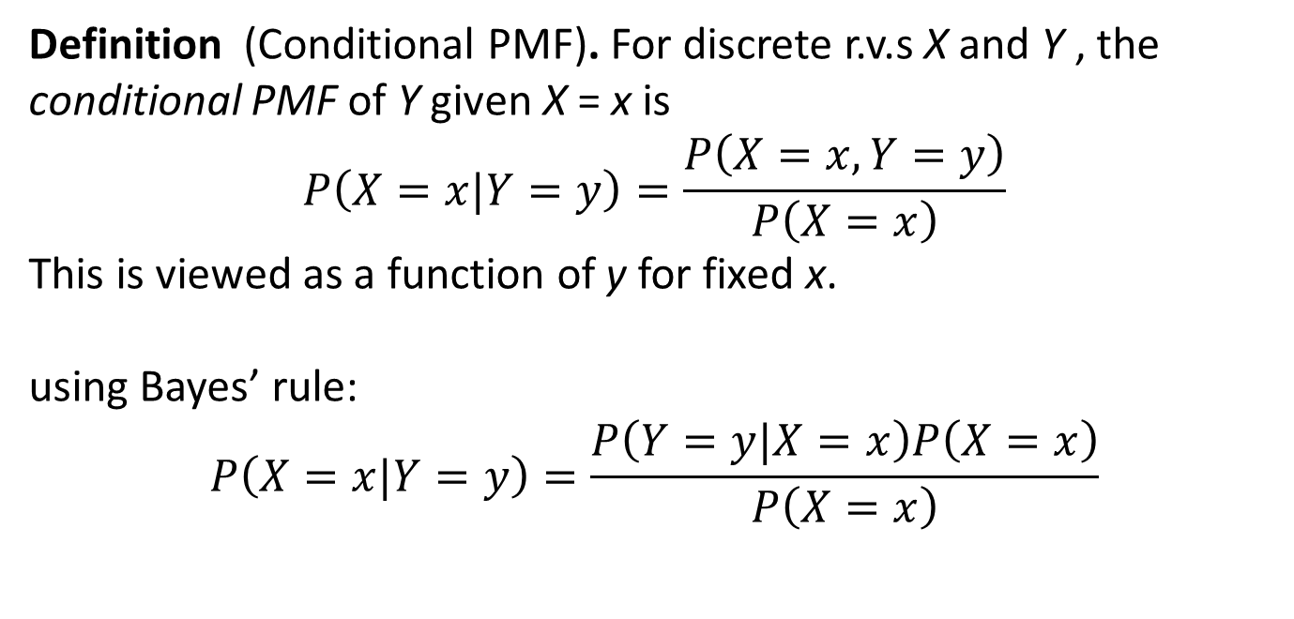
Conditional PMF for discrete r.v.s
Definition (Conditional PMF). For discrete r.v.s X and Y , the conditional PMF of Y given X = x is
$$P\left(X=x|Y=y\right)=\frac{P\left(X=x,Y=y\right)}{P\left(X=x\right)}$$
This is viewed as a function of y for fixed x.
using Bayes’ rule: $$P\left(X=x|Y=y\right)=\frac{P\left(Y=y|X=x\right)P\left(X=x\right)}{P\left(X=x\right)}$$

Slide 13
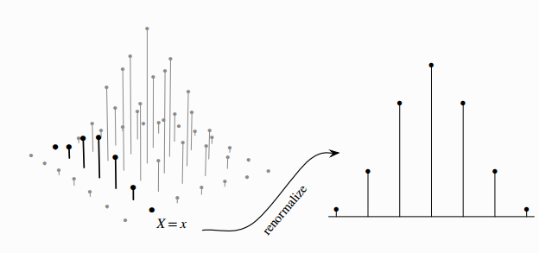
Conditional PMF for discrete r.v.s
Renormalizing make that the sum of all values is equal to 1.

Slide 14
Distribution of function of joint discrete r.v.s
Definition (distribution for Z=g(X,Y)). For discrete r.v.s X and Y , a new random variable Z=g(X,Y), find Z‘s PMF
f(x, y) = P(X = x, Y = y)
P(X + Y = z) = ∑_{(x, y): x + y = z} P(X = x, Y = y)

Slide 15
Example 6.1b Cards
There is a box with 4 cards:
1
2
3
4
You draw two cards without replacement.
What is the p.m.f. of the sum of the face values?

Slide 16
Example 6.1b Cards
Probability model
S = ordered pairs of cards, equally likely outcomes
X = face value on first card
Y = face value on second card
We want the p.m.f. of X + Y
P(X + Y = 4)
= 1/6.
= P(X = 1, Y = 3) + P(X = 2, Y = 2) + P(X = 3, Y = 1)
1/12
0
1/12

Slide 17
Joint distribution function
In general
P(X + Y = z) = ∑_{(x, y): x + y = z} P(X = x, Y = y)
to calculate P(X + Y = z) we need to know
f(x, y) = P(X = x, Y = y)
for every pair of values x, y.
This is the joint p.m.f. of X and Y.

Slide 18
Example 6.1b Cards
2 | 0
3 | 1/6
4 | 1/6
5 | 1/3
6 | 1/6
7 | 1/6
8 | 0
joint p.m.f. of X and Y:
X
1
2
3
4
Y
2
3
4
5
0 | 1/12 | 1/12 | 1/12
1/12 | 0 | 1/12 | 1/12
1/12 | 1/12 | 0 | 1/12
1/12 | 1/12 | 1/12 | 0
1
3
4
5
6
2
4
5
6
7
3
5
6
7
8
4
p.m.f. of X + Y

Slide 19
Question for you
There is a box with 4 cards:
1
2
3
4
You draw two cards without replacement.
What is the p.m.f. of the larger face value max(X,Y) ?
What if you draw the cards with replacement?

Slide 20
Marginal probabilities
X
1
2
3
4
Y
0 | 1/12 | 1/12 | 1/12
1/12 | 0 | 1/12 | 1/12
1/12 | 1/12 | 0 | 1/12
1/12 | 1/12 | 1/12 | 0
1/4
1/4
1/4
1/4
1
2
P(Y = y) = ∑_{x} P(X = x, Y = y)
3
4
1/4 | 1/4 | 1/4 | 1/4
1
P(X = x) = ∑_{y} P(X = x, Y = y)

Slide 21
Example 6.1c Red and blue balls
You have 3 red balls and 2 blue balls. Draw 2 balls at random. Let X be the number of blue balls drawn.
Replace the 2 balls and draw one ball. Let Y be the number of blue balls drawn this time.
X
Y
0
1
2
Y
9/50 | 18/50 | 3/50
6/50 | 12/50 | 2/50
3/5
2/5
0
1
X
3/10 | 6/10 | 1/10

Slide 22
Independent discrete r.v.s
Let X and Y be discrete random variables.
X and Y are independent if
P(X = x, Y = y) = P(X = x) P(Y = y)
for all possible values of x and y.

Slide 23
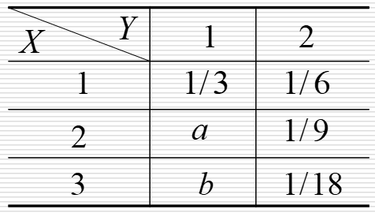
Independent discrete r.v.s
Jiont PMF of X and Y is as following:
Find a and b so that X and Y are independent.

Slide 24
Example 6.1d
Alice tosses 3 coins and so does Bob. What is the probability they get the same number of heads?
Probability model
Let A / B be Alice’s / Bob’s number of heads
Each of A and B is Binomial(3, ½)
A and B are independent
We want to know P(A = B)

Slide 25
Example 6.1d
Solution 1
A
0
1
2
3
B
B
1/64 | 3/64 | 3/64 | 1/64
3/64 | 9/64 | 9/64 | 3/64
3/64 | 9/64 | 9/64 | 3/64
1/64 | 3/64 | 3/64 | 1/64
1/8
3/8
3/8
1/8
0
1
2
3
A
1/8 | 3/8 | 3/8 | 1/8
P(A = B) = 20/64 = 31.25%

Slide 26
Example 6.1d
Solution 2
P(A = B)
= ∑_{h} P(A = h, B = h)
= ∑_{h} P(A = h) P(B = h)
= ∑_{h} (C(3, h) 1/8) (C(3, h) 1/8)
= 1/64 (C(3, 0)² + C(3, 1)² + C(3, 2)² + C(3, 3)²)
= 20/64
= 31.25%

Slide 27

Independent Poisson
Let X be Poisson(μ) and Y be Poisson(ν). If X and Y are independent, what is the p.m.f. of Z=X + Y?
Intuition
0
1
X is the number of blue raindrops in 1 sec
Y is the number of red raindrops in 1 sec
X + Y is the total number of raindrops
E[X + Y] = E[X] + E[Y] = μ + ν

Slide 28
Independent Poisson
The p.m.f. of X + Y is
P(X + Y = z)
= ∑_{(x, y): x + y = z} P(X = x, Y = y)
= ∑_{(x, y): x + y = z} P(X = x) P(Y = y)
= ∑_{(x, y): x + y = z} (e^{-μ} μ^{x}/x!) (e^{-ν} ν^{y}/y!)
= e^{-(μ+ν)} ∑_{(x, y): x + y = z} (μ^{x}ν^{y})/(x!y!)
= (e^{-(μ+ν)}/z!) ∑_{(x, y): x + y = z} (μ^{x}ν^{y}) z!/(x!y!)
= (e^{-(μ+ν)}/z!) ∑_{(x, y): x + y = z} C(z, x) μ^{x}ν^{z -} ^{x}
= (e^{-(μ+ν)}/z!) (μ + ν)^{z}
This is the formula for Poisson(μ + ν)

Slide 29
Expectation
E[X, Y] doesn’t make sense, so we look at E[g(X, Y)] for example E[X + Y], E[min(X, Y)]
There are two ways to calculate it:
Method 1.
First obtain the p.m.f. f_{Z} of Z = g(X, Y)
Then calculate E[Z] = ∑_{z} z f_{Z}(z)
Method 2.
Calculate directly using the formula
E(g(X, Y)) = ∑_{x,} _{y} g(x, y) f_{XY}(x, y)

Slide 30
Method 1: Example
A
0
1
2
3
min(A, B)
B
0
0
0
0
1/64 | 3/64 | 3/64 | 1/64
3/64 | 9/64 | 9/64 | 3/64
3/64 | 9/64 | 9/64 | 3/64
1/64 | 3/64 | 3/64 | 1/64
15/64
33/64
15/64
1/64
0
0
0
1
1
1
1
1
0
1
2
2
2
2
0
1
2
3
3
3
E[min(A, B)] =
0⋅15/64 + 1⋅33/64 + 2⋅15/64 + 3⋅1/64
= 33/32

Slide 31
Method 2: Example
A
0
1
2
3
B
0
0
0
0
1/64 | 3/64 | 3/64 | 1/64
3/64 | 9/64 | 9/64 | 3/64
3/64 | 9/64 | 9/64 | 3/64
1/64 | 3/64 | 3/64 | 1/64
0
0
1
1
1
1
0
1
2
2
2
0
1
2
3
3
E[min(A, B)] =
0⋅1/64 + 0⋅3/64 + ... + 3⋅1/64
= 33/32

Slide 32
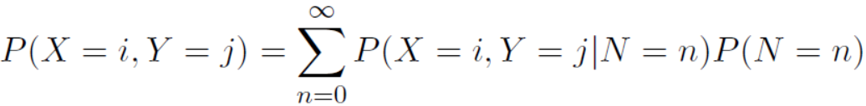
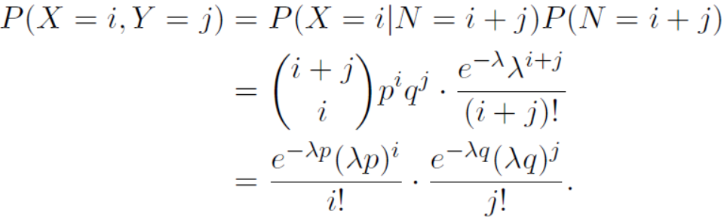
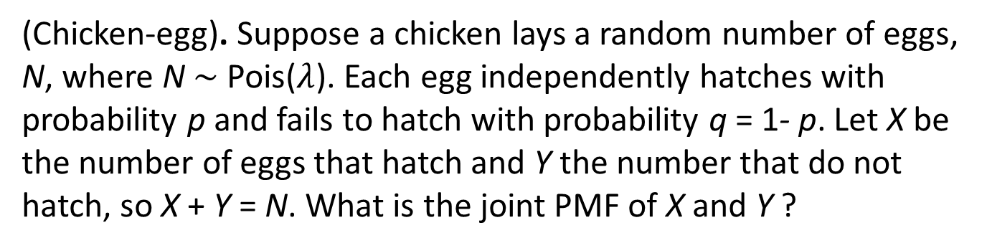
Example 6.1e Chicken-egg
(Chicken-egg). Suppose a chicken lays a random number of eggs, N, where N $\sim$Pois($λ$). Each egg independently hatches with probability p and fails to hatch with probability q = 1- p. Let X be the number of eggs that hatch and Y the number that do not hatch, so X + Y = N. What is the joint PMF of X and Y ?

Slide 33
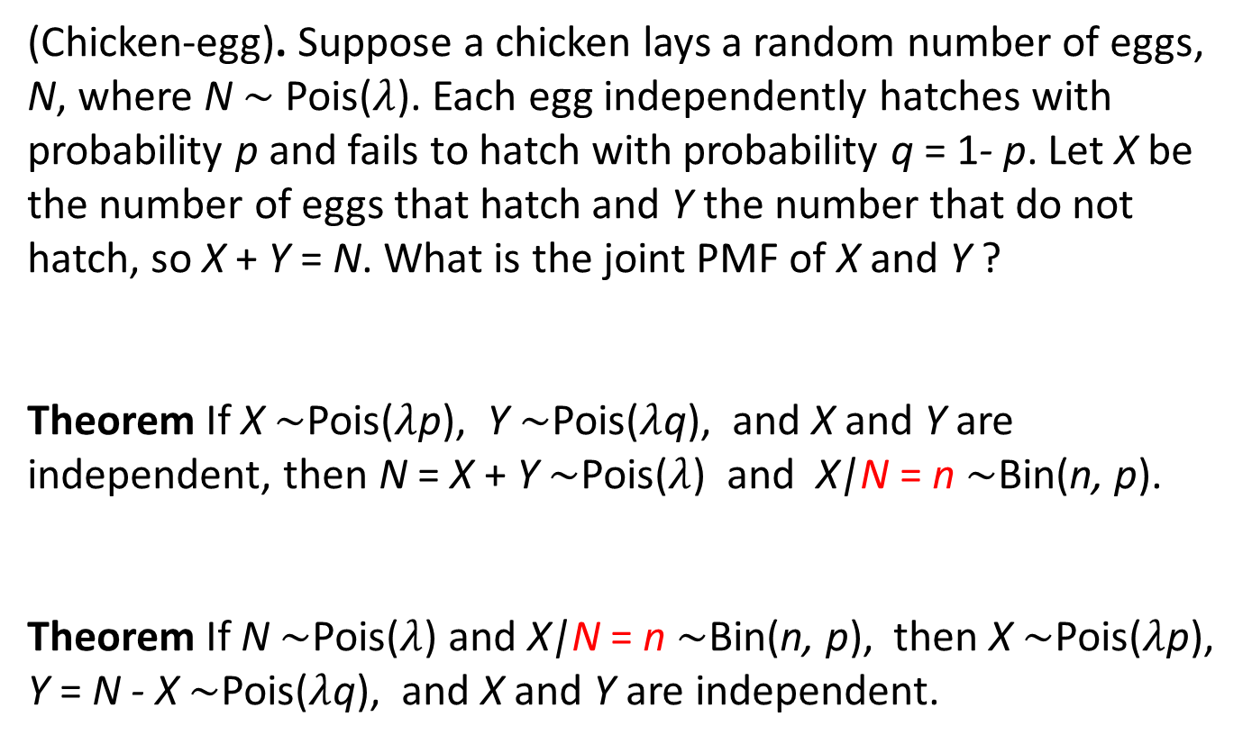
Example 6.1e Chicken-egg
(Chicken-egg). Suppose a chicken lays a random number of eggs, N, where N $\sim$Pois($λ$). Each egg independently hatches with probability p and fails to hatch with probability q = 1- p. Let X be the number of eggs that hatch and Y the number that do not hatch, so X + Y = N. What is the joint PMF of X and Y ?
Theorem If X $\sim$Pois($λ$p), Y $\sim$Pois($λ$q), and X and Y are independent, then N = X + Y $\sim$Pois($λ$) and X|N = n $\sim$Bin(n, p).
Theorem If N $\sim$Pois($λ$) and X|N = n $\sim$Bin(n, p), then X $\sim$Pois($λ$p), Y = N - X $\sim$Pois($λ$q), and X and Y are independent.

Slide 34
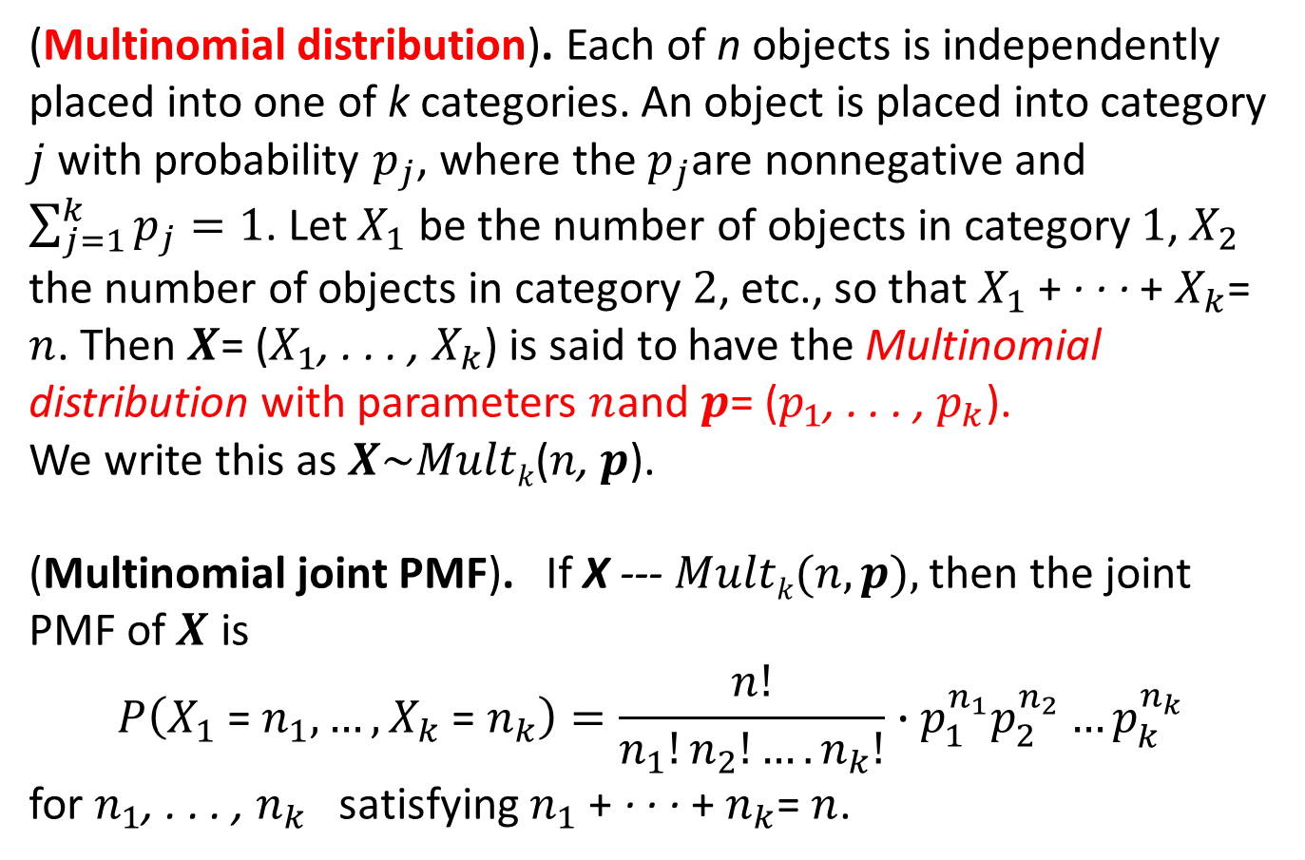
Multinomial distributions
(Multinomial distribution). Each of n objects is independently placed into one of k categories. An object is placed into category $j$ with probability $p_{j}$, where the $p_{j}$are nonnegative and $\sum_{j=1}^{k}{p_{j}=1}$. Let $X_{1}$ be the number of objects in category $1$, $X_{2}$ the number of objects in category $2$, etc., so that $X_{1}$ + · · · + $X_{k}$= $n$. Then $X$= ($X_{1}$, . . . , $X_{k}$) is said to have the Multinomial distribution with parameters $n$and $p$= ($p_{1}$, . . . , $p_{k}$).
We write this as $X\sim Multk$($n$, $p$).
(Multinomial joint PMF). If X --- $Multk(n, p),$then the joint PMF of $X$ is
$$P\left(X_{1} \text{= }n_{1}, …,X_{k} \text{= }n_{k}\right)=\frac{n!}{n_{1}!n_{2}!….n_{k}!}∙p_{1}^{n_{1}}p_{2}^{n_{2}}…p_{k}^{n_{k}}$$
for $n_{1}$, . . . , $n_{k}$ satisfying $n_{1}$ + · · · + $n_{k}$= $n$.

Slide 35
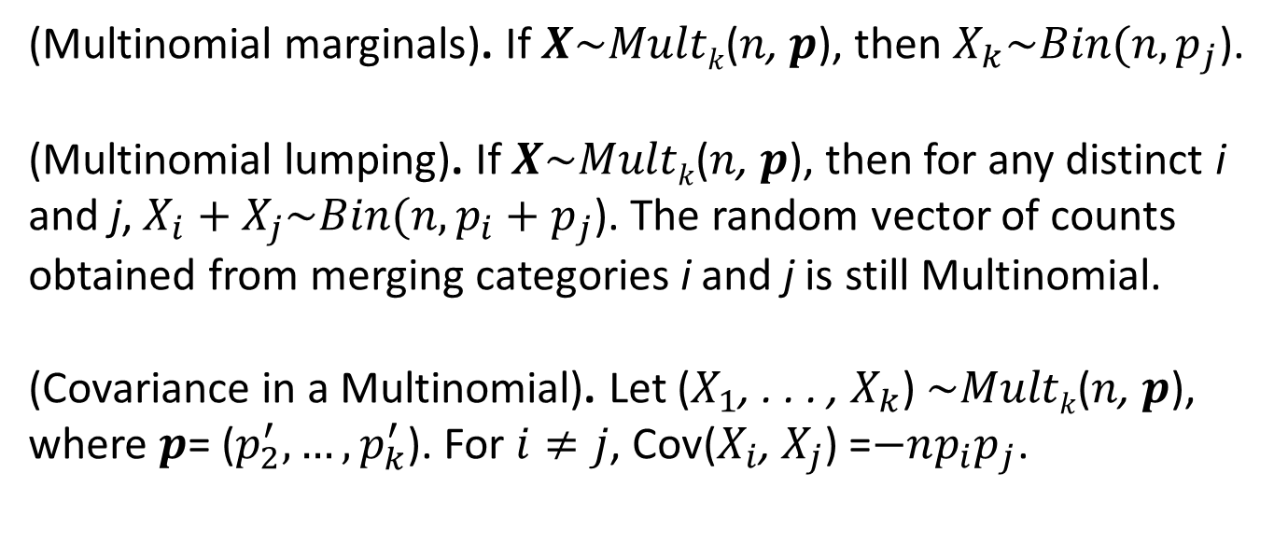
Multinomial distributions
(Multinomial marginals). If $X\sim Multk$($n$, $p$), then $X_{k}\sim Bin(n,p_{j}$).
(Multinomial lumping). If $X\sim Multk$($n$, $p$), then for any distinct i and j, $X_{i}+X_{j}\sim Bin(n,{p_{i}+p}_{j}$). The random vector of counts obtained from merging categories i and j is still Multinomial.
(Covariance in a Multinomial). Let ($X_{1}$, . . . , $X_{k}$) $\sim Multk$($n$, $p$), where $p$= ($p_{2}^{′}, …,p_{k}^{′}$). For $i≠j$, Cov($X_{i}$, $X_{j}$) =$−np_{i}p_{j}$.

Slide 36
the cheat sheet
X, Y discrete joint p.m.f. f_{XY}(x, y) = P(X = x, Y = y)
Probability of an event (determined by X, Y)
P(A) = ∑_{(x, y) in A} f_{XY} (x, y)
Derived random variables
Z = g(X, Y)
f_{Z}(z) = ∑_{(x, y): g(x, y) = z} f_{XY}(x, y)
Marginal p.m.f.’s
f_{X}(x) = ∑_{y} f_{XY}(x, y)
Independence
f_{XY}(x, y) = f_{X}(x) f_{Y}(y) for all x, y
Expectation of Z = g(X, Y)
E[Z] = ∑_{x,} _{y} g(x, y) f_{XY}(x, y)

Slide 37
2D Continuous random variables
A pair of continuous random variables X, Y can be specified either by their joint c.d.f.
F_{XY}(x, y) = P(X ≤ x, Y ≤ y)
or by their joint p.d.f.
∂
∂
f_{XY}(x, y)
=
F_{XY}(x, y)
∂x
∂y
P(x < X ≤ x + ε, y < Y ≤ y + δ)
=
lim
ε, δ → 0
εδ

Slide 38
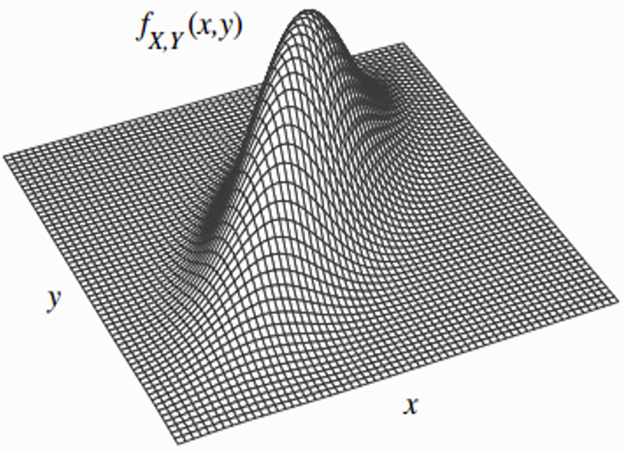
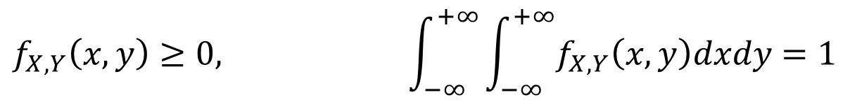
2D Continuous random variables
$$f_{X,Y}\left(x,y\right)≥0, \int_{−∞}^{+∞}{\int_{−∞}^{+∞}{f_{X,Y}\left(x,y\right)dxdy=1}}$$

Slide 39
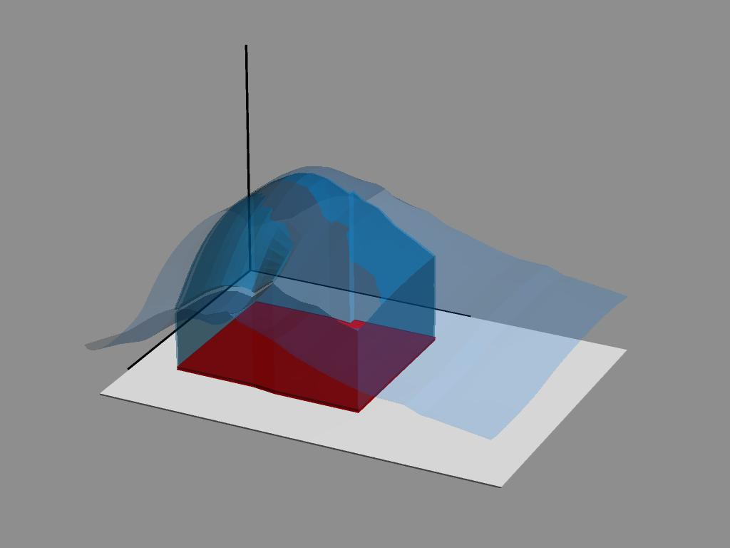
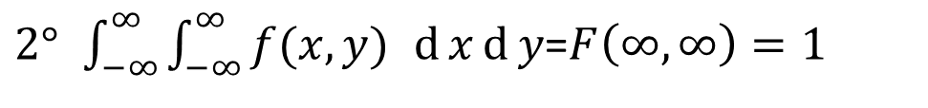
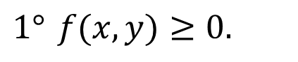
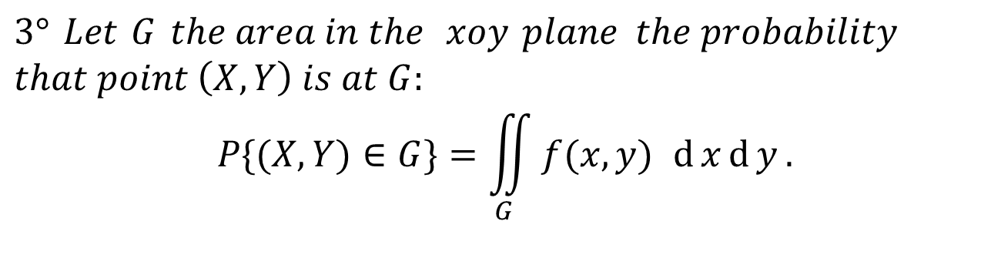
2D PDF’s properties
$$1° f(x,y)≥0.$$
$2° \int_{−∞}^{∞}{\int_{−∞}^{∞}{f(x,y) }}d{x}d{y}$=$F\left(∞,∞\right)=1$
$$3° Let G the area in the xoy plane the probability$$
$$that point \left(X,Y\right) is at G:$$
$$P\{(X,Y)∈G\}=\iint_{G}{f(x,y) d{x}d{y}}.$$
则有
G

Slide 40
An example
Rain drops at a rate of 1 drop/sec. Let X and Y be the arrival times of the first and second raindrop.
X
Y
F(x, y) = P(X ≤ x, Y ≤ y)
f(x, y)
=
∂
∂
F(x, y)
∂x
∂y

Slide 41
Continuous marginals
Given the joint c.d.f F_{XY}(x, y) = P(X ≤ x, Y ≤ y), we can calculate the marginal c.d.f.s:
F_{X}(x) = P(X ≤ x) = lim F_{XY} (x, y)
y → ∞
F_{Y}(y) = P(Y ≤ y) = lim F_{XY} (x, y)
x → ∞
P(X ≤ x)
Exponential(1)

Slide 42
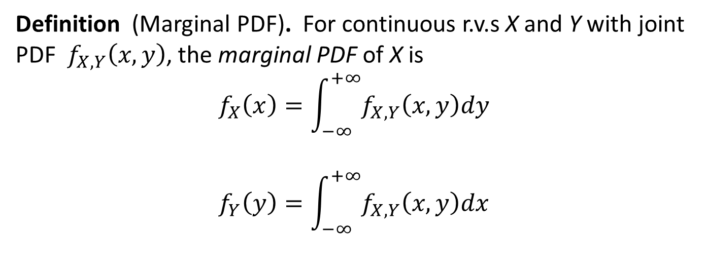
Marginal PDF for continuous r.v.s
Definition (Marginal PDF). For continuous r.v.s X and Y with joint PDF${ f}_{X,Y}\left(x,y\right)$, the marginal PDF of X is
$$f_{X}\left(x\right)=\int_{−∞}^{+∞}{f_{X,Y}\left(x,y\right)dy}$$
$$f_{Y}\left(y\right)=\int_{−∞}^{+∞}{f_{X,Y}\left(x,y\right)dx}$$

Slide 43
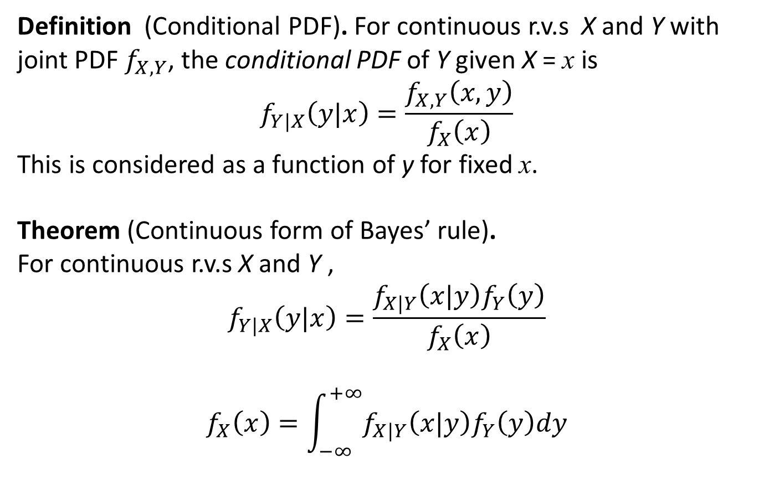
Conditional PDF for continuous r.v.s
Definition (Conditional PDF). For continuous r.v.s X and Y with joint PDF $f_{X,Y}$, the conditional PDF of Y given X = x is $$f_{Y|X}\left(y|x\right)=\frac{f_{X,Y}\left(x,y\right)}{f_{X}\left(x\right)}$$
This is considered as a function of y for fixed x.
Theorem (Continuous form of Bayes’ rule).
For continuous r.v.s X and Y ,
$$f_{Y|X}\left(y|x\right)=\frac{f_{X|Y}\left(x|y\right)f_{Y}\left(y\right)}{f_{X}\left(x\right)}$$
$$f_{X}\left(x\right)=\int_{−∞}^{+∞}{f_{X|Y}\left(x|y\right)f_{Y}\left(y\right)dy}$$

Slide 44
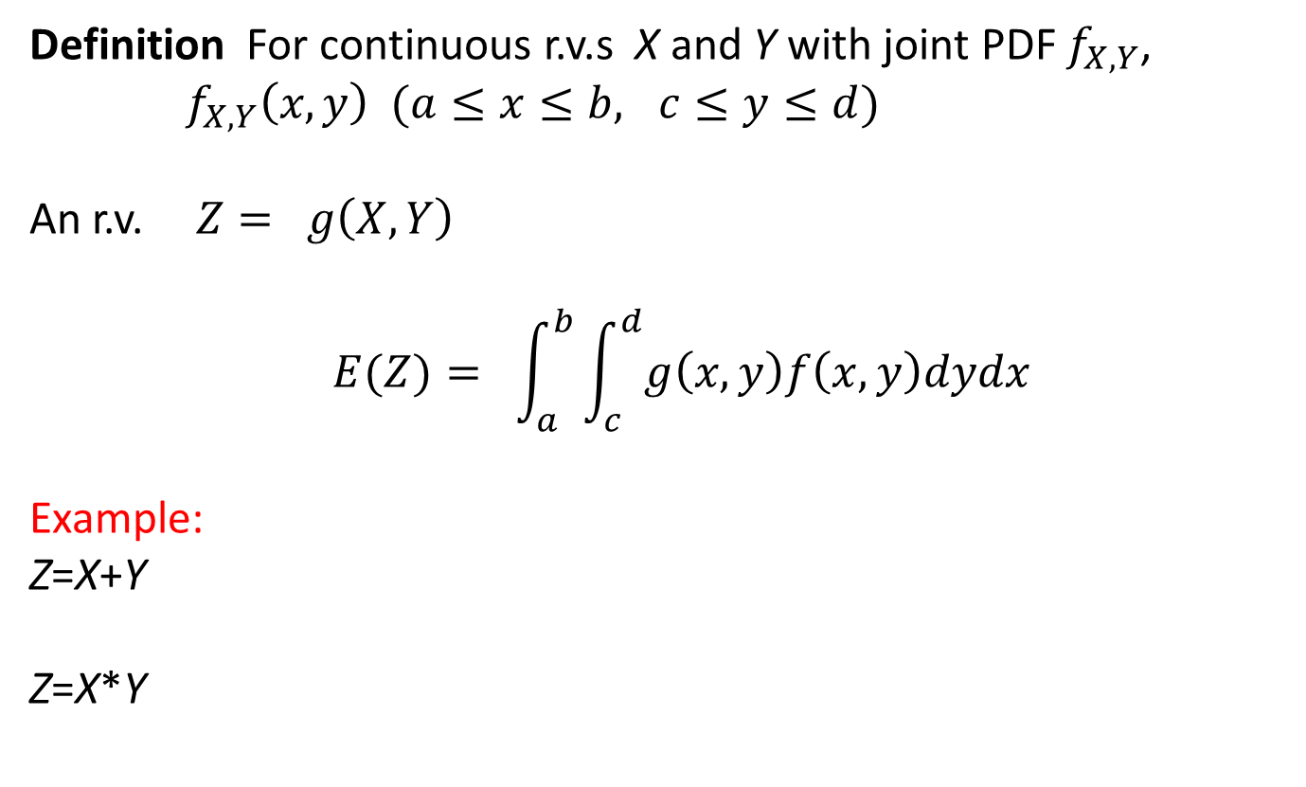
Exception of function of joint r.v. X and Y
Definition For continuous r.v.s X and Y with joint PDF $f_{X,Y}$, ${{ f}_{X,Y}\left(x,y\right) (a≤x≤b, c≤y≤d) }_{}$
An r.v. ${ Z=}_{}g\left(X,Y\right)$
$${ E(Z)=}_{}\int_{a}^{b}{\int_{c}^{d}{g\left(x,y\right)f\left(x,y\right)dydx}}$$
Example:
Z=X+Y
Z=X*Y

Slide 45
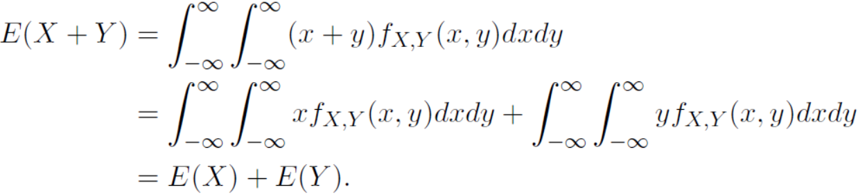
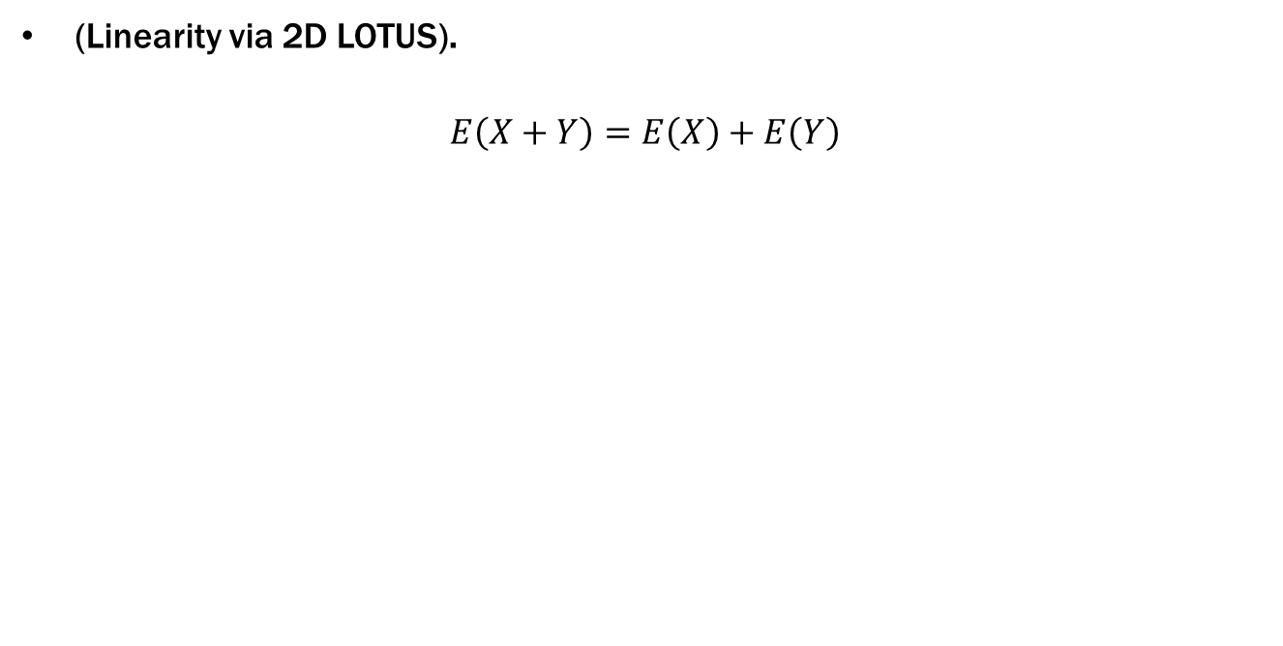
(Linearity via 2D LOTUS).
$$E\left(X+Y\right)=E\left(X\right)+E\left(Y\right)$$

Slide 46
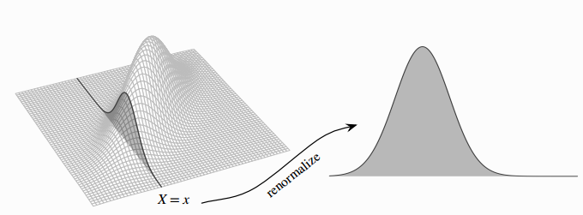
Conditional PDF for continuous r.v.s

Slide 47
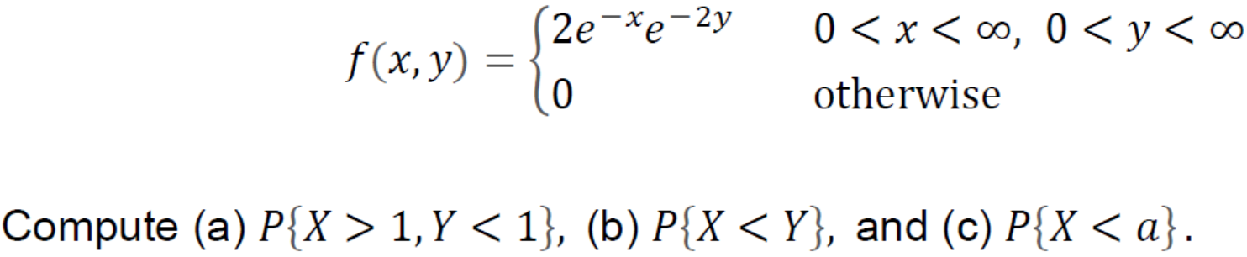
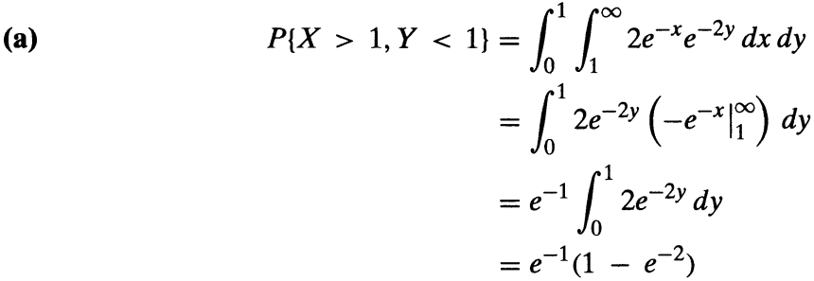
Example 6.1f
The joint density function of and is given by

Slide 48
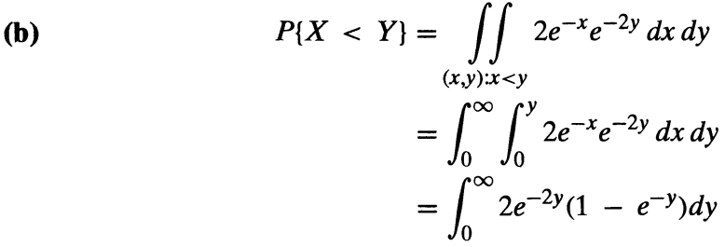
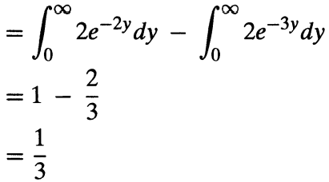
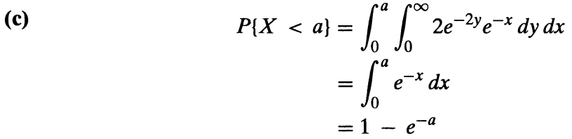
Example 6.1f

Slide 49
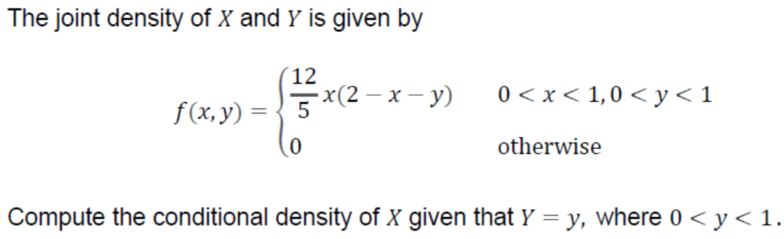
Marginal PDF for continuous r.v.s

Slide 50
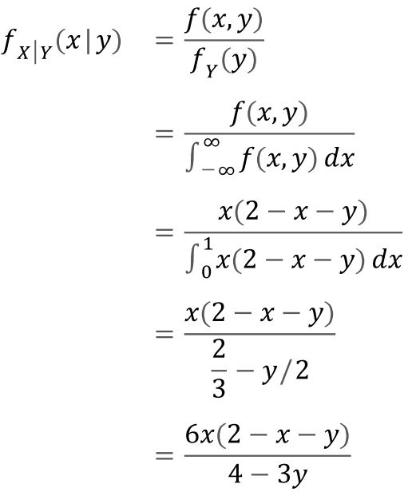
Marginal PDF for continuous r.v.s

Slide 51

Marginal PDF for continuous r.v.s

Slide 52


Marginal PDF for continuous r.v.s

Slide 53















Example：
$$Joint PDF for X and Y is as following.$$
$$\left\{\begin{aligned}& \\ &\end{aligned}\right.$$
$$6, x^{2}≤y≤x,$$
$$f(x,y)$$
$$=$$
$$0, otherwise$$
$$Find f_{X}(x), f_{Y}(y).$$
$$\int_{−∞}^{∞}{f(x,y)}d{y}$$
$$f_{X}(x)=$$
$$y$$
$$(1,1)$$
$$when 0≤x≤1 ,$$
$$\int_{−∞}^{∞}{f(x,y)}d{y}$$
$$y=x$$
$$f_{X}(x)=$$
$$y=x^{2}$$
$$=\int_{x^{2}}^{x}{6d{y}}$$
$$O$$
$$x$$

Slide 54















$$y$$
$$(1,1)$$
$$=6(x−x^{2}).$$
$$y=x$$
$$when x<0 or x>1,$$
$$y=x^{2}$$
$$\int_{−∞}^{∞}{f(x,y)}d{y}$$
$$O$$
$$x$$
$$f_{X}(x)=$$
$$=0.$$
$$\left\{\begin{aligned}& \\ &\end{aligned}\right.$$
$$6(x−x^{2}),$$
$$0≤x≤1 ,$$
$$f_{X}(x)=$$
$$0,$$
$$otherwise .$$

Slide 55



















$$when 0≤y≤1 ,$$
$$y$$
$$(1,1)$$
$$\int_{−∞}^{∞}{f(x,y)}d{x}$$
$$f_{Y}(y)=$$
$$y=x$$
$$y=x^{2}$$
$$\int_{y}^{\sqrt{y}}{6d{x}}$$
$$=$$
$$O$$
$$x$$
$$6(\sqrt{y}−y),$$
$$=$$
$$=\int_{−∞}^{∞}{f(x,y)}d{x}$$
$$when y<0 OR y>1,$$
$$f_{Y}(y)$$
$$=0.$$
$$\left\{\begin{aligned}& \\ &\end{aligned}\right.$$
$$6(\sqrt{y}−y),$$
$$0≤y≤1 ,$$
$$f_{Y}(y)$$
$$=$$
$$Otherwise$$
$$0,$$

Slide 56
the continuous cheat sheet
X, Y continuous with joint p.d.f. f_{XY}(x, y)
Probability of an event (determined by X, Y)
P(A) = ∫∫_{A} f_{XY} (x, y) dxdy
Derived random variables
Z = g(X, Y)
f_{Z}(z) = ∫∫_{(x, y): g(x, y) = z} f_{XY}(x, y) dxdy
Marginal p.m.f.’s
∞
f_{X}(x) = ∫_{-∞} f_{XY}(x, y) dy
Independence
f_{XY}(x, y) = f_{X}(x) f_{Y}(y) for all x, y
Expectation of Z = g(X, Y)
E[Z] = ∫∫ g(x, y) f_{XY}(x, y) dxdy

Slide 57



6.2 Independent Random Variables
The random variables X and Y are said to be independent if, for any two sets of real numbers A and B :
In terms of the joint distribution function F of X and Y , r.v.s X and Y are independent if :

Slide 58


6.2 Independent Random Variables
Discrete random variables X and Y :
Continuous random variables X and Y :

Slide 59

6.2 Independent Random Variables
Suppose that the joint PDF $f_{X,Y}$ of X and Y factors as
$f_{X,Y}\left(x,y\right)=g\left(x\right)h\left(y\right)$
for all x and y, where g and h are nonnegative functions. Then X and Y are independent. Also, if either g or h is a valid PDF, then the other one is a valid PDF too and g and h are the marginal PDFs of X and Y , respectively. (The analogous result in the discrete case also holds.)

Slide 60
Example 6.2a
Are the random variables X and Y are independent ?
You have 3 red balls and 2 blue balls. Draw 2 balls at random. Let X be the number of blue balls drawn.
Replace the 2 balls and draw one ball. Let Y be the number of blue balls drawn this time.
X
Y
0
1
2
Y
9/50 | 18/50 | 3/50
6/50 | 12/50 | 2/50
3/5
2/5
0
1
X
3/10 | 6/10 | 1/10

Slide 61

Example 6.2b
Are the random variables X and Y are independent ?
The joint density of and is given by

Slide 62
6.3 Common Joint distributions
1. 2D Uniform distribution
2. Bivariate (2D) Normal distribution
3. Multinomial distribution

Slide 63


2D Uniform distribution
Definition: given 2D r.v.s (X, Y), if its joint PDF is:
$$f(x,y) =\left\{\begin{matrix}\frac{1}{A_{G}}，(x,y)∈G; \\ 0，otherwise\begin{matrix} & \end{matrix}\end{matrix}\right.$$
$G$is a region in the plane of xoy and $A_{G}$ is its area, then, the 2D r.v. (X, Y) distributed as 2D Uniform distribution.

Slide 64

Independent uniform random variables
Let X, Y be independent Uniform(0, 1).
1
if 0 < x, y < 1
f_{XY}(x, y) = f_{X}(x) f_{Y}(y) =
0
if not
f_{XY}(x, y)
1
if 0 < x < 1
f_{X}(x) =
0
if not
1
if 0 < y < 1
f_{Y}(y) =
0
if not

Slide 65
Example 6.3a Meeting time
Alice and Bob arrive in Airport between 12 and 1pm. How likely arrive within 15 minutes of one another?
Probability model
Arrival times X, Y are independent Uniform(0, 1)
Event A: |X – Y| ≤ ¼
P(A) = ∫∫_{A} f_{XY} (x, y) dxdy
= ∫∫_{A} 1 dxdy
= area(A) in [0, 1]²

Slide 66
Meeting time
1
Event E: |X – Y| ≤ ¼
y = x + ¼
P(E) = area(E)
y
= 1 – (3/4)²
y = x – ¼
= 7/16
0
0
x
1

Slide 67

Example 6.3b
Consider a circle of radius R and suppose that a point within the circle is randomly chosen in such a manner that all regions within the circle of equal area are equally likely to contain the point. If we let the center of the circle denote the origin and define X and Y to be the coordinates of the point, then, since (X,Y ) is equally likely to be near each point in the circle, it follows that the joint density function of and is given by.

Slide 68


Example 6.3b

Slide 69



Example 6.3b

Slide 70

Example 6.3b

Slide 71

Example 6.3b

Slide 72


Example 6.3b

Slide 73

Buffon’s needle
A needle of length l is randomly dropped on a ruled sheet.
What is the probability that the needle hits one of the lines?

Slide 74
Buffon’s needle
The lines are 1 unit apart
X
Θ
X is the distance from midpoint to nearest line
1
Θ is angle with horizontal
Probability model
X is Uniform(0, ½)
Θ is Uniform(0, π)
X, Θ are independent

Slide 75
Buffon’s needle
l/2
The p.d.f. is
X
Θ
f_{XΘ}(x, θ) = f_{X}(x) f_{Θ}(θ) =
2/π
1
for 0 < X < ½, 0 < Θ < π
½
l/2
The event H = “needle hits line” happens when X < (l/2) sinΘ
x
H
0
0
θ
π

Slide 76
Buffon’s needle
If l ≤ 1 (short needle) then (l/2) sinθ is always ≤ ½:
^{π}
^{(l/2)sinθ}
P(H) = ∫∫_{B} f_{XΘ}(x, θ) dxdθ
= ∫₀ ∫₀ 2/π dxdθ
P(H)
^{π}
^{(l/2) sinθ}
= ∫₀ ∫₀ 2/π dxdθ
^{π}
= ∫₀ (l /π) sinθ dθ
^{π}
= (l /π) ∫₀ sinθ dθ
= 2l /π.

Slide 77


Bivariate (2D) Normal distribution
Definition: given 2D r.v.s (X, Y), if its joint PDF is:
$$f(x,y) =\frac{1}{2πσ_{1}σ_{2}\sqrt{1−ρ^{2}}}e^{−\frac{1}{2(1−ρ^{2})}[\frac{(x−μ_{1})^{2}}{σ_{1}^{2}}−2ρ\frac{(x−μ_{1})(y−μ_{2})}{σ_{1}σ_{2}}+\frac{(y−μ_{2})^{2}}{σ_{2}^{2}}]}$$
$Here μ_{1},{ μ}_{2},{ σ}_{1}, σ_{2} and ρ are parameter，σ_{1}>0$， $σ_{2}>0, −1<ρ<1,$ $Then （X,Y） distributed as 2D Normal distribution ,$
$denoted as$ $（X,Y）\sim N(μ_{1},μ_{2},σ_{1},σ_{2},ρ)$

Slide 78


Bivariate (2D) Normal distribution
$$(X,Y)\sim N\left(μ_{1},μ_{2},σ_{1},σ_{2},ρ\right), the shapes of f\left(x,y\right) are shown as follows.$$

Slide 79
Bivariate (2D) Normal distribution

Slide 80


Bivariate (2D) Normal distribution
Consideration:
If (X,Y)’s marginal PDF are normal distribution, then is its joint PDF bivariate normal distribution?
$$\frac{1}{2π}e^{−\frac{x^{2}+y^{2}}{2}}(1+\sin{x}\sin{y}),$$
$$f(x,y)=$$

Slide 81

6.3 Distribution of Function of Bivariate R.V.
For continuous r.v.s X and Y with joint PDF $f_{X,Y}$,
$${ f}_{X,Y}\left(x,y\right)$$
For a new r.v. $Z=g\left(X,Y\right)$, To find ${ F}_{z}$(z) and ${ f}_{z}$(z)
Some simple function $g\left(∙\right)$:
(1)$Z=X+Y or Z=X−Y$ or $Z=\left|X−Y\right|$
(2) $Z=Max\left(X,Y\right) or Z=Min\left(X,Y\right)$
(3) $Z=X/Y$
(4) $Z=XY$

Slide 82



6.3 Distribution of Function of Bivariate R.V.
Calculate the distribution of $Z=X+Y$ from the distributions of $X$ and $Y$ when and are independent.
Suppose that $X$ and $Y$ are independent, continuous random variables having probability density functions $f_{X}$and $f_{Y} .$
If the symbol $a$ is replaced by $z$, we can obtain the PDF of Z

Slide 83

6.3 Distribution of Function of Bivariate R.V.
Convolution sums and integrals

Slide 84

Example 6.3.a
Exponential convolution

Slide 85

6.3 Distribution of Function of Bivariate R.V.
Exercises:
The joint density of X and Y is given by
To find the PDF of r.v. Z= X+Y

Slide 86




6.3 Distribution of Function of Bivariate R.V.
The PDFs of independent X and Y is given by
To find the PDF of r.v. Z= X+Y

Slide 87


6.3 Distribution of Function of Bivariate R.V.
The PDFs of independent X and Y is given by

Slide 88
Example 6.3.b
X and Y are independent, X~Norm(0,1), Y~Norm(0,1),
Z=X+Y, to Find the PDF of r.v. Z

Slide 89


Normal distribution
X and Y are independent, $X\sim N\left(μ_{1},σ_{1}^{2}\right),Y\sim N\left(μ_{2},σ_{2}^{2}\right),$
Z=aX + bY, Then
$$X\sim N\left({aμ}_{1}+bμ_{2},{a^{2}σ}_{1}^{2}+{b^{2}σ}_{2}^{2}\right)$$

Slide 90


6.3 Distribution of Function of Bivariate R.V.
Example (Comparing Exponentials of different rates). Let T₁ $\sim$Expo( $λ1$) and T₂ $\sim$Expo($λ2$ ) be independent. Find P (T₁ < T₂). (T₁ lifetime of refrigerator T₂ lifetime of refrigerator)

Slide 91





6.3 Distribution of Function of Bivariate R.V.
Example 7.1.24 (Cauchy PDF). Let X and Y be i.i.d. N ($0, 1$), and let T = X/Y . The distribution of T is a famous named distribution called the Cauchy distribution. Meanwhile, find the PDF of T

Slide 92


Some examples for distributions of Z= X+Y

Slide 93


Some examples of Z= X+Y

Slide 94


6.3 Distribution of Function of Bivariate R.V.
$X_{1},⋯,X_{n} are I.I.D ，CDF of X_{i} is F(x)$, $PDF of X_{i} is f(x)$
$$F_{Z}(z)=P(Z≤z)=P(X_{i}≤z,i=1,⋯,n) \\ =P(X_{1}≤z)P(X_{2}≤z)⋯P(X_{n}≤z) \\ =F_{1}(z)F_{2}(z)⋯F_{n}(z)\begin{matrix} & −∞<z<+∞\end{matrix}$$

Slide 95

6.3 Distribution of Function of Bivariate R.V.
$X_{1},⋯,X_{n} are I.I.D ，CDF of X_{i} is F(x)$, $PDF of X_{i} is f(x)$
$F_{Y}\left(y\right)=P\left(Y≤y\right)$ $=1−P\left(Y>y\right)$
$$=1−P(X_{i}>y,i=1,⋯,n) \\ =1−P(X_{1}>y,X_{2}>y,⋯,X_{n}>y) \\ =1−P(X_{1}>y)P(X_{2}>y),⋯,P(X_{n}>y) \\ =1−(1−F_{1}(y))(1−F_{2}(y))⋯(1−F_{n}(y)) \\ \begin{matrix} & −∞<y<+∞\end{matrix}$$

Slide 96

6.3 Distribution of Function of Bivariate R.V.
$X_{1},⋯,X_{n} are I.I.D ，CDF of X_{i} is F(x)$, $PDF of X_{i} is f(x)$ CDF $of$ $Z and Y ：$ $$F_{Z}(z)=[F(z)]^{n},\begin{matrix} & −∞<z<+∞\end{matrix} \\ F_{Y}(y)=1−[1−F(y)]^{n},\begin{matrix} & −∞<y<+∞\end{matrix}$$
PDF $of$ $Z and Y$ $$f_{Z}(z)=n[F(z)]^{n−1}f(z)\begin{matrix} & −∞<z<+∞\end{matrix} \\ f_{Y}(y)=n[1−F(y)]^{n−1}f(y)\begin{matrix} & −∞<y<+∞\end{matrix}$$

Slide 97

6.3 Distribution of Function of Bivariate R.V.
Example (Minimum of independent Expos). Let X Y be i.i.d., with $X\sim$ Expo($λ$). Let Z = min(X, Y).
To find Z’s PDF

Slide 98

6.3 Distribution of Function of Bivariate R.V.
Theorem Let g be a function from $ℝ^{2}$to $ℝ$. If X and Y are discrete, then $E\left(g\left(x,y\right)\right)=\sum_{x}{\sum_{y}{P\left(X=x,Y=y\right).}}$
If X and Y are continuous with joint PDF $f_{X,Y}\left(x,y\right)$ , then $$E\left(g\left(x,y\right)\right)=\int_{−∞}^{+∞}{\int_{−∞}^{+∞}{{g\left(x,y\right)f}_{X,Y}\left(x,y\right)dxdy}}$$

Slide 99


6.3 Distribution of Function of Bivariate R.V.
Example (Expected distance between two Uniforms). For X, Y i.i.d. $\sim$ Unif(0, 1), find E(|X - Y |).

Slide 100


6.3 Distribution of Function of Bivariate R.V.
Example 7.2.3 (Expected distance between two Normals). For X, Y i.i.d $\sim$ N ($0, 1$), find E(|X - Y |).

Slide 101

6.4 Joint Distribution of Function of Random Variables
(Change of variables)

Slide 102







6.4 Joint Distribution of Function of Random Variables
2D random variable cases:
$$Given X_{1} and{ X}_{2}, know their joint PDF{ f}_{{X_{1}X}_{2}}\left(x_{1},x_{2}\right)$$
$$Y_{1} and{ Y}_{2}$$

Slide 103


6.4 Joint Distribution of Function of Random Variables
2D random variable cases:
$$Given X_{1} and{ X}_{2}, know their joint PDF{ f}_{{X_{1}X}_{2}}\left(x_{1},x_{2}\right)$$
$$Y_{1} and{ Y}_{2}$$

Slide 104



6.4 Joint Distribution of Function of Random Variables
Example: $X\sim N(0,1)$ and $Y\sim N(0,1)$ are independent, $Z=X, W=ρX+τY$, here$τ=\sqrt{1−ρ^{2}}$
To find the joint PDF of (Z, W)

Slide 105

6.4 Joint Distribution of Function of Random Variables

Slide 106



6.5 Covariance and correlation
For two r.v.s $X$ and $Y$ , $Z=X+Y$,
if we know $Var\left(X\right) and Var(Y)$
Investigate:
$$Var(Z)=Var(X+Y)$$
I$f X$ and $Y$ are independent:
$Var(Z)=Var(X)$+$Var(X)$
I$f X$ and $Y$ are not independent:
$Var(Z)=Var(X)$+$Var\left(Y\right)+2E\left(X−EX\right)E\left(Y−EY\right)$
$=Var(X)\text{+} Var\left(Y\right)+2(E\left(XY\right)−EXEY)$
Hint: $Var(X+Y)$= $E\left[{(X+Y−E(X+Y))}^{2}\right]$

Slide 107


6.5 Covariance and correlation
Definition (Covariance). The covariance between r.v.s X and Y is
$$Cov(X, Y ) = E((X − EX)(Y − EY))$$
Multiplying this out and using linearity, we have an equivalent expression:
$$Cov(X, Y ) = E(XY) − E(X)E(Y)$$
Theorem If X and Y are independent, then they are uncorrelated.

Slide 108



6.5 Covariance and correlation
Definition (Covariance). The covariance between r.v.s X and Y is
$$Cov(X, Y ) = E((X − EX)(Y − EY))$$
Multiplying this out and using linearity, we have an equivalent expression:
$$Cov(X, Y ) = E(XY) − E(X)E(Y)$$
Example distributions of r.v.s X and Y are follows, compute $Cov(X, Y )$

Slide 109

6.5 Covariance and correlation
Definition (Covariance). The covariance between r.v.s X and Y is
$$Cov(X, Y ) = E((X − EX)(Y − EY))$$
Multiplying this out and using linearity, we have an equivalent expression:
$$Cov(X, Y ) = E(XY) − E(X)E(Y)$$
Example distributions of r.v.s X and Y are follows, compute $Cov(X, Y )$

Slide 110

6.5 Covariance and correlation

Slide 111

6.5 Covariance and correlation
Covariance has the following key properties. 1. Cov(X, X) = Var(X).
2. Cov(X, Y ) = Cov(Y, X).
3. Cov(X, c) = 0 for any constant c.
4. Cov(aX, Y ) = aCov(X, Y ) for any constant a.
5. Cov(X + Y, Z) = Cov(X, Z) + Cov(Y, Z).
6. Cov(X + Y, Z + W ) = Cov(X, Z) + Cov(X, W ) + Cov(Y, Z) + Cov(Y, W ).
7. Var(X + Y ) = Var(X) + Var(Y ) + $2$Cov(X, Y ). For n r.v.s X1, . . . , $X_{n}$,
Var(X1 + · · · + Xn) = Var(X1) + · · · + Var($X_{n}$) + $2\sum_{i<j}{\text{Cov}\text{(}X_{i},X_{j}\text{)}}$

Slide 112

6.5 Covariance and correlation
Definition (Correlation). The correlation between r.v.sX and Y is $$Corr\left(X,Y\right)=\frac{Cov\left(X,Y\right)}{\sqrt{Var\left(X\right)Var\left(Y\right)}}$$
Properties Linear transformation will not affect the Corr
Question：Corr(cX+b,Y)=？

Slide 113





6.5 Covariance and correlation
Theorem (Correlation bounds). For any r.v.s X and Y , $$−1≤Corr\left(X,Y\right)≤1$$

Slide 114


6.5 Covariance and correlation
Example (Exponential max and min). Let X and Y be i.i.d. Expo(1) r.v.s. Find the correlation between max(X, Y ) and min(X, Y ).

Slide 115

6.6 Other numerical features (Summaries) of r.v.s
Learned numerical features
1-D random variables:
E(X) : mean weighted by probability values
Var(X) : measure the variance of r.v. X
2-D random variables:
Cov(X,Y): describe the linear relation between X and Y
Correlation $ρ$: standardized Cov(X, Y)
Other numerical features
1-D random variables:
Median
Mode
Moments
n-D random variables:
Covariance matrix

Slide 116



6.6 Other numerical features (Summaries) of r.v.s
Median
Mode

Slide 117
6.6 Other numerical features (Summaries) of r.v.s
Example
X~Expo(2), to find Find Median of X
Y~Norm(1,4), to find Mode of Y

Slide 118

6.6 Other numerical features (Summaries) of r.v.s
Kinds of Moments
Example
E(X) is the 1-th moment
Var(X) is 2-th central moment

Slide 119


6.6 Other numerical features (Summaries) of r.v.s
Symmetry

Slide 120

6.6 Other numerical features (Summaries) of r.v.s
Symmetry and Central moments

Slide 121

6.6 Other numerical features (Summaries) of r.v.s
Covariance matrix
$Given 2D r.v. vector X=\left({X_{1} \atop X_{2}}\right)$
$E\left[\left({X_{1} \atop X_{2}}\right)\right]=\left({{E(X}_{1}) \atop E(X_{2})}\right)$
$\left({X_{1} \atop X_{2}}\right)$* $\left(X_{1},X_{2}\right)$= $\left[\begin{matrix}X_{1}X_{1} & X_{1}X_{2} \\ X_{2}X_{1} & X_{2}X_{2}\end{matrix}\right]$
$E\left[\begin{matrix}X_{1}X_{1} & X_{1}X_{2} \\ X_{2}X_{1} & X_{2}X_{2}\end{matrix}\right]$= $\left[\begin{matrix}{E(X}_{1}X_{1}) & E(X_{1}X_{2}) \\ E(X_{2}X_{1}) & {E(X}_{2}X_{2})\end{matrix}\right]$

Slide 122

6.6 Other numerical features (Summaries) of r.v.s
Covariance matrix
$Given X=\left({X_{1} \atop X_{2}}\right)$
$M=E\left(XX^{T}\right)−E\left(X\right)E(X^{T})$
$\left[\begin{matrix}Cov(X_{1},X_{1}) & Cov(X_{1},X_{2}) \\ Cov(X_{2},X_{1}) & Cov(X_{2},X_{2})\end{matrix}\right]$
$\left[\begin{matrix}Var(X_{1}) & Cov(X_{1},X_{2}) \\ Cov(X_{2},X_{1}) & Var(X_{2})\end{matrix}\right]$

Slide 123

6.6 Other numerical features (Summaries) of r.v.s
Covariance matrix
$Given X=\left({X_{1} \atop X_{2}}\right)$, if $X$ distributes as
$Norm(μ_{1},μ_{2}σ_{1}^{2}{,σ}_{2}^{2},ρ)$
$M=E\left(XX^{T}\right)−E\left(X\right)E(X^{T})$
$\left[\begin{matrix}σ_{1}^{2} & ρσ_{1}σ_{2} \\ ρσ_{1}σ_{2} & {,σ}_{2}^{2}\end{matrix}\right]$

